Slide 1
Insurance Management System
Aditya Ellhe-22204009
Avisha Shah-22204008
Jash Mehta-22204010
Harsh Joshi-22204012
Project Guide
Prof.Jayshree Jha

Slide 2
Contents
Introduction
Objectives
Scope
Features/Functionality
Project Outcomes
Technology Stack
Block Diagram
Conclusion

Slide 3


1.Introduction
Insurance management systems are designed to streamline and simplify the process of managing insurance policies, claims, and customer information.
These systems are widely used by insurance companies, brokers, and agencies to improve operational efficiency, reduce costs, and enhance customer service.
With an insurance management system in place, organizations can easily track policies, process claims, and access customer data in real-time.

Slide 4
2.Objectives of the project
To be designed with the aim of providing a user-friendly, intuitive experience for all users, regardless of their level of technical knowledge.
To have a platform that will be optimized to ensure the best possible performance and user experience, while also providing a modern and aesthetically pleasing layout.
To have an user friendly and Secure Login page.
The primary goal of the insturance management system is to improve the users track policy.

Slide 5
3.Scope of our project
To have a attractive interface for the user
To create a handy website for the user
To provide customer support and address any issues or questions users may have.
To continuously update and improve the website with new features and functionality based on user feedback.
To make it easy for the user to input data.

Slide 6
4.Features/Functionality
The design of insurance management system will be modern with a focus on simplicity and ease of use. All features will be easy to find and use.
It helps the user to apply to various policies and connect with the agent easily with the QnA section.
The system can be accessed by multiple users
The admin can create a category and add various policies to it.

Slide 7
5. Project outcomes
> The platform will give user various categories of policies to choose from and apply for it.
> The insurance management project enables users to easily access the website and go through it.
> The project should have a secure login

Slide 8


6. Technology Stack

Slide 9
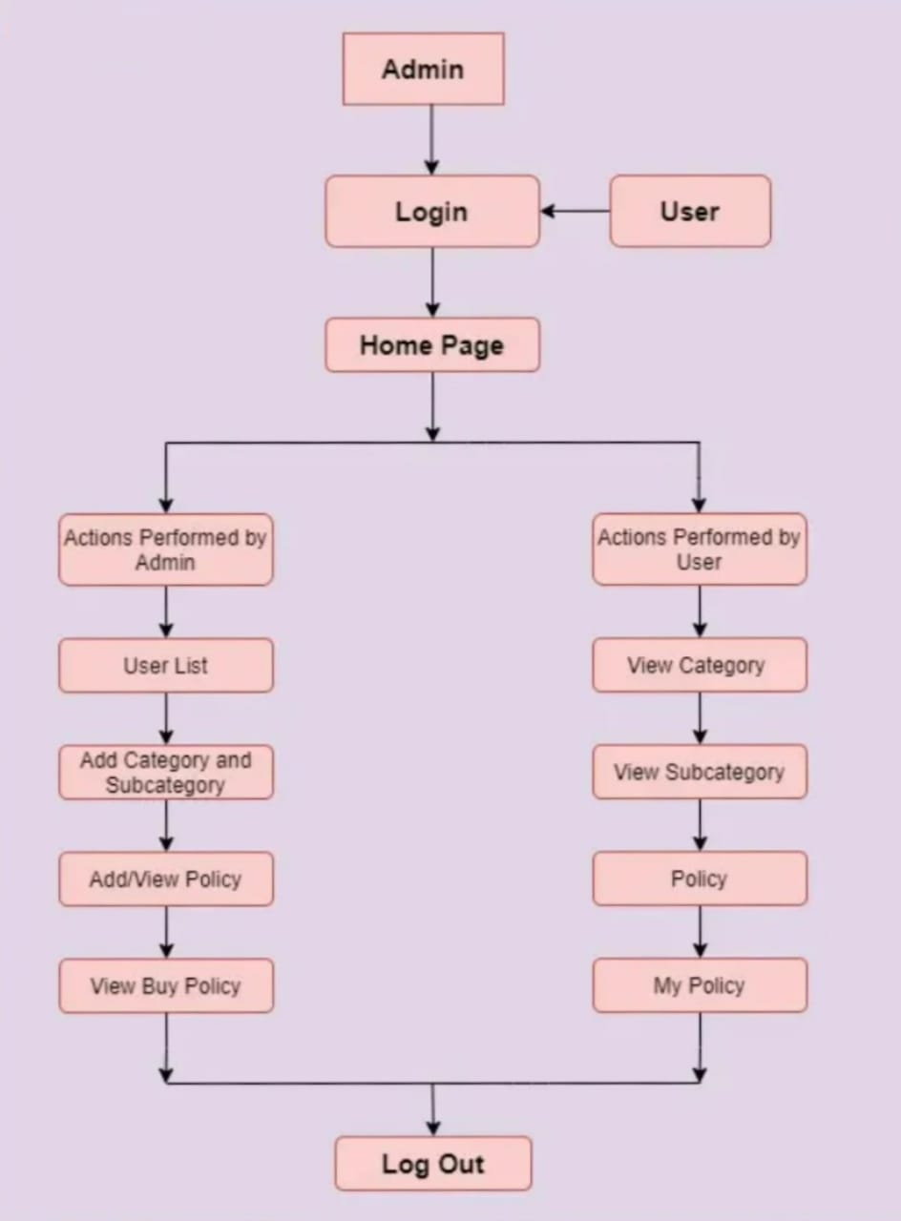
7. Block Diagram

Slide 10
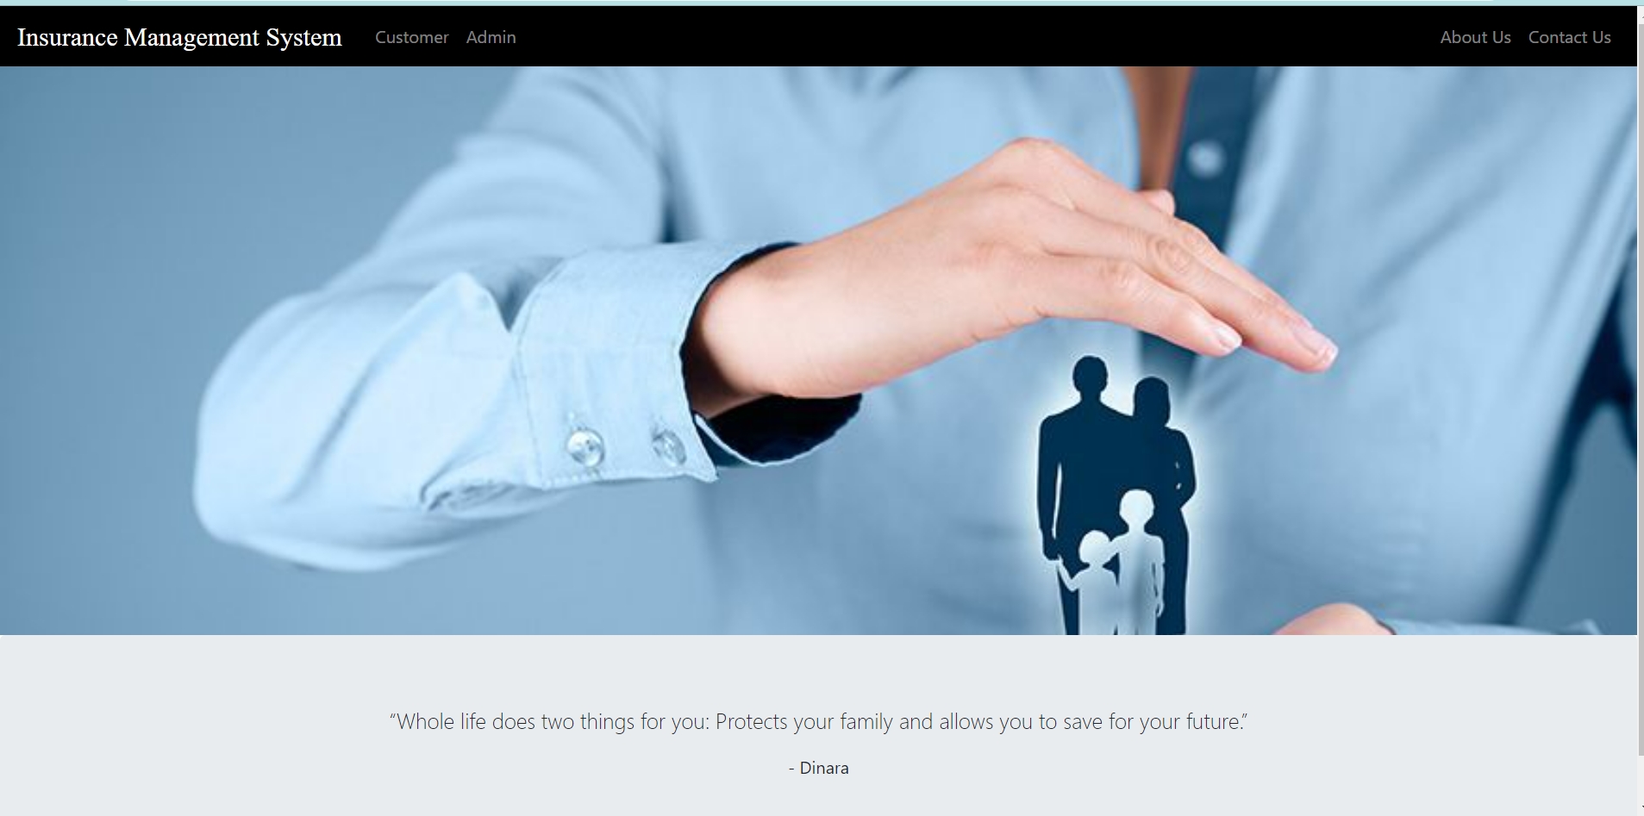
Output
Landing Page

Slide 11
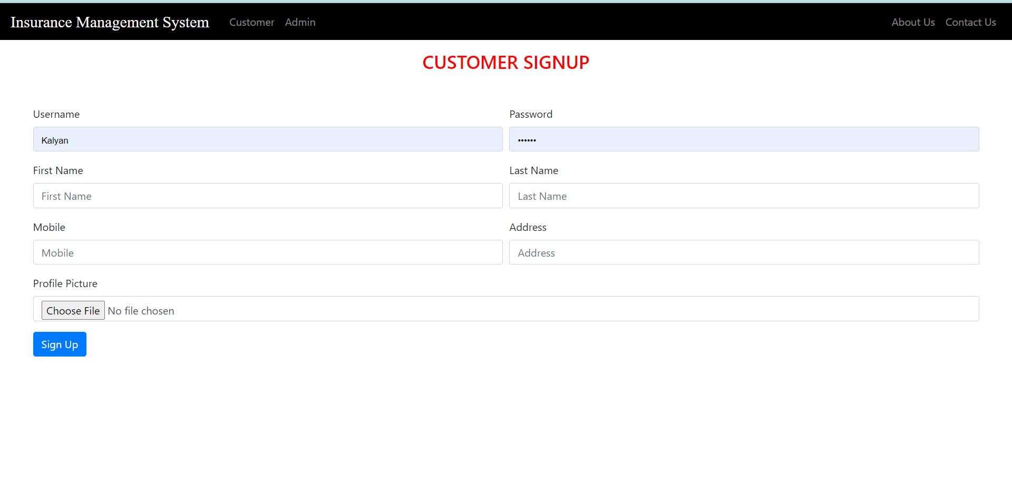
Registration page

Slide 12
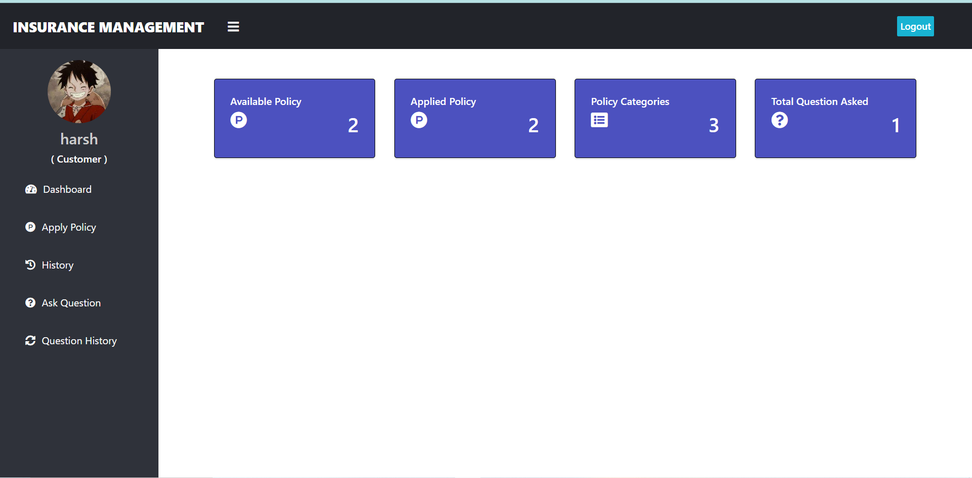
User’s Home Page

Slide 13
8. Conclusion
Insurance management system offers features that make it eazy to keep track of customers registrations and applied policies. The design of it will be modern with a focus on simplicity and ease of use. All features will be easy to find and use. It offers a secure login to the user

Slide 14
Thank you !!

